Slide 1

Unit 6
Sociology

Slide 2

Reading
Text A
Work and
Personal Satisfaction
Lead-in task
While reading
After reading tasks

Slide 3

Lead-in: What is Sociology?
It is a social science that focuses on society, human social behavior, patterns of social relationships, social interaction, and aspects of culture associated with everyday life.

Slide 4

Lead-in: Sociology Examples
trends in population growth
how people interact with the environment,
how society is divided into different classes based on wealth
social relations and life satisfaction
work–life balance
...

Slide 5

Lead-in: Brainstorming
Q: What makes a happy life or what adds to your life satisfaction?

Slide 6
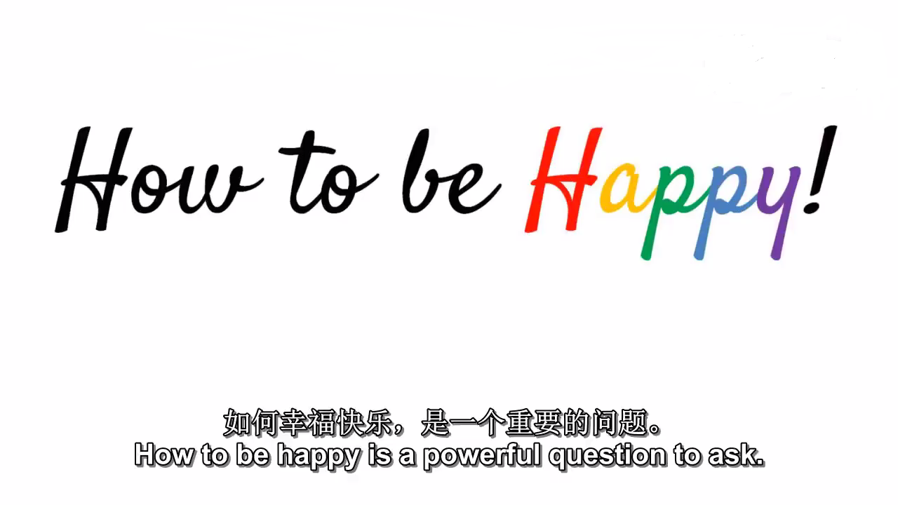
Video - Questions: 1. What do happy people have in common? 2. How to increase happiness in the long run? 3. What is the key for our well-being?

Slide 7
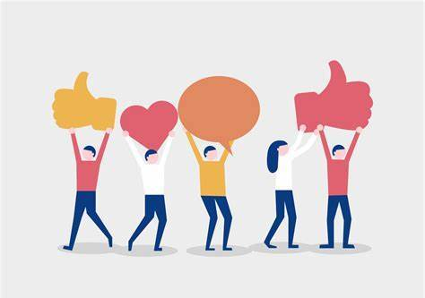
Happy people are
healthier,
more productive at study or job,
have deep relationships with others,
help other people and volunteer more,
more creative problem solvers

Slide 8

Increase happiness in the
long run by
nurturing relationships,
having new experiences,
helping others,
being grateful for what you have
Key for well-being
feeling connected to a deeper purpose, mission or direction in life

Slide 9
Text A While reading
The focused issue
Work and personal satisfaction
Reading task
How to achieve personal satisfaction in your work?

Slide 10
Text A While reading
Supplementary Information
1. Life satisfaction
Life satisfaction is the way people perceive how their life has been, how they feel about it, and where it is going in the future. It is a measure of well-being and may be assessed in terms of mood, satisfaction with relations with others, and with achieved goals, self-concepts, and self-perceived ability to cope with daily life, etc. It is having a favorable attitude of one’s life as a whole rather than their current feelings. Life satisfaction has been measured in relation to economic standing, amount of education, personal experiences, and living condition as well as many other factors.

Slide 11
Text A While reading
Supplementary Information
2. Signature strengths
Signature strengths are the strongest or most prominent in one’s strengths profile. They are some of the most central characteristics of one’s personal identity. A strength can be identified as a signature strength if a person feels it is essential to who he / she is as a person, and feels effortless and energizing when he / she enacts the strength.

Slide 12
Text A While reading
Supplementary Information
2. Signature strength
American positive psychologists Christopher Peterson and Martin Seligman developed the Values in Action (VIA) Classification of character strengths and virtues in their book Character Strengths and Virtues: A Handbook and Classification (2004), which is a classification of 24 character strengths in people. Strengths such as perseverance, bravery, gratitude, teamwork, kindness, and curiosity are part of the framework. The VIA Survey, which is a 240-item questionnaire that measures 24 key character strengths, is used as a scientific tool to help people discover their character strengths.

Slide 13
Text A While reading
Supplementary Information
3. Work orientation
Work orientation refers to an individual’s motivation and responses to work. The first area covers why people work, which analyzes need hierarchies, self-actualization, and intrinsic and extrinsic motivations. The second area addresses the ways in which individuals react to the activity of work. Job satisfaction and commitment have been given the most attention when sociologists study reactions to work. The major issues in the study of job satisfaction are: What produces job satisfaction? What are the consequences of differing levels of job satisfaction? Is it a global or unitary concept, or should its facets be investigated?

Slide 14

Work and Personal Satisfaction
Reading: Text A

Slide 15
Structure
Background: sea change in work life and education
Paras. 1- 3
Anecdote: an orderly’s story
Paras. 4-9
Three kinds of work orientation
Paras. 10-11

Slide 16
Text A - Discussion
What is the sea change in work life?
What is the changing trend of our economy?
What is the sea change in education?
Why did the orderly at the hospital draw the author’s attention?
How did the orderly define his work?
What is a Job?
What is a Career?
What is a Calling?

Slide 17
1 Work life is undergoing a sea change in the wealthiest nations. Money, amazingly, is losing its power. The stark findings about life satisfaction - that beyond the safety net, more money adds little or nothing to subjective well-being - are starting to sink in. While real income in America has risen 16 % in the last 30 years, the percentage of people who describe themselves as “very happy” has fallen from 36% to 29 %. “Money really cannot buy happiness,” declared The New York Times.
经历巨变
clear明显的，鲜明的
主观幸福感
(信息、事实等)被充分理解
Supporting evidence

Slide 18
Text A While reading
Language Support
The stark findings about life satisfaction—that beyond the safety net, more money adds little or nothing to subjective well-being—are starting to sink in. (Para. 1)
Paraphrase: People are starting to recognize and understand the unpleasant findings about life satisfaction that earning more money can hardly improve their emotional evaluation of life when the amount of money they possess has ensured a stable life for them.

Slide 19
1 But when employees catch up with the Times and figure out that raises, promotions, and overtime pay buy not one whit of increased life satisfaction, what then? Why will a qualified individual choose one job over another? What will cause an employee to be steadfastly loyal to the company he or she works for? For what incentive will a worker pour heart and soul into making a quality product?
加薪、升职和加班费
一点也不
坚定地，不动摇地
激励，刺激
全身心地投入到…

Slide 20
Text A While reading
Language Support
For what incentive will a worker pour heart and soul into making a quality product? (Para. 1)
句首“For what …” 即“what … for”的倒装结构，表示“为了···”。
The idiom “pour heart and soul into” means to do something with all of your energy, interest, and passion.
e.g. Oliver has quit his job and spent two years pouring his heart and soul into creating the best work of his life.

Slide 21
2 Our economy is rapidly changing from a money economy to a satisfaction economy. These trends go up and down (when jobs are scarcer, personal satisfaction has a somewhat lesser weight; when jobs are abundant, personal satisfaction counts for more), but the trend for two decades is decidedly in favor of personal satisfaction. Law is now the most highly paid profession in America, having surpassed medicine during the 1990s. Yet the major New York law firms now spend more on retention than on recruitment, as their young associates-and even partners-are leaving law in droves for work that makes them happier.
货币经济—满意度经济
重要
(formal) 超过
(formal)维持，保留 retention (of staff).
同事，伙伴
成群结队
Supporting evidence

Slide 22
2 The lure of a lifetime of great riches at the end of several years of grueling 80-hour weeks as a lowly associate has lost much of its power. The newly minted coin of this realm is life satisfaction. Millions of Americans are staring at their jobs and asking, “Does my work have to be this unsatisfying? What can I do about it?” My answer is that your work can be much more satisfying than it is now, and that by using your signature strengths at work more often, you should be able to recraft your job to make it so.
财富，财产
地位低的
freshly/newly minted: recently produced or invented 新产生的，新发明的
显著优势
你能够将你的工作重塑成你心仪的样子

Slide 23
Text A While reading
Language Support
The lure of a lifetime of great riches at the end of several years of grueling 80-hour weeks as a lowly associate has lost much of its power. The newly-minted coin of this realm is life satisfaction. (Para. 2)
In this sentence, “of a lifetime of great riches at the end of several years of grueling 80-hour weeks as a lowly associate” is a very long modifier that describes the subject “the lure”.
Paraphrase: It’s no longer a tempting idea to spend 80 hours per week working unremittingly in a low-level position in a law firm for years in order to obtain wealth and abundance, and people care more about life satisfaction now.
“The newly-minted coin” is a metaphor that refers to a new concern that people are having. 新的关注焦点

Slide 24
coin of the realm
something that is especially valuable in a particular field or area
e.g.
You’d better get this unique idea of yours patented—intellectual property is the coin of the realm for inventors.

Slide 25
3 I’m sure you are skeptical. What, money lost its power in a capitalistic economy? Dream on! I would remind you about another “impossible” sea change that swept education 40 years ago. When I went to school (a military one), and for generations before, education was based on humiliation. The dunce cap and the paddle were the big guns in the arsenal of teachers. These went the way of the wooly mammoth and the dodo, and did so astonishingly quickly.
别做梦了
教育基于羞辱
笨蛋高帽和戒尺是教师“武器库”中的两杆大枪。但它们最终像猛犸象和渡渡鸟一样绝迹了，而且其消亡的速度之快令人吃惊。

Slide 26


dunce cap and paddle
a conical cap formerly used as a punishment for slow learners at school
a piece of wood with a handle, used for hitting children as a punishment

Slide 27
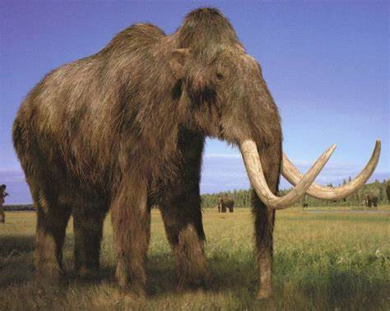
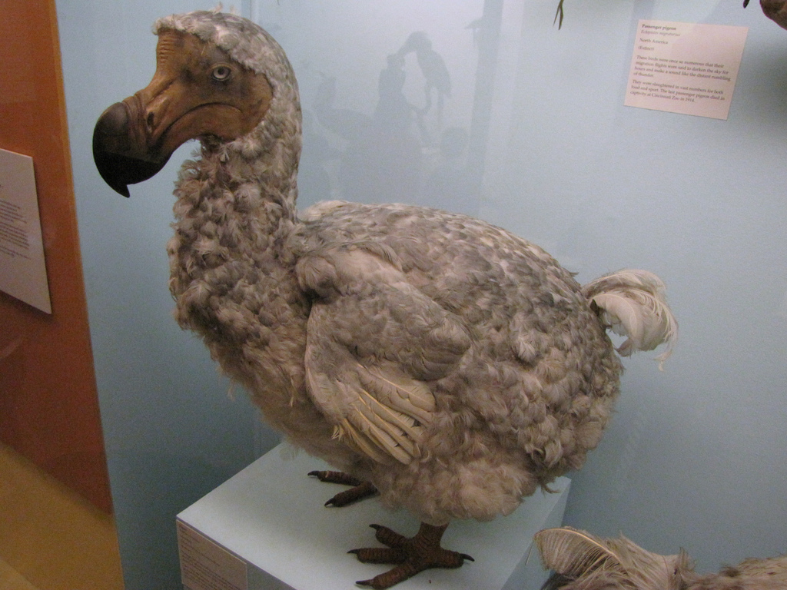
Extinct Creatures
mammoth
dodo

Slide 28
3 They disappeared because educators discovered a better route to learning: rewarding strengths, kindly mentoring, delving deeply into one subject rather than memorizing a panoply of facts, emotional attachment of the student to a teacher or a topic, and individualized attention. There is also a better route to high productivity than money.
…的途径/方法
探索，探究
[formal] a panoply of 大量

Slide 29
4 I had played poker with Bob Miller every Tuesday night for the past 25 years. Bob was a runner. October was his favorite month. He would run through the Adirondacks, never missing a run up Gore Mountain, religiously return to Philadelphia each Tuesday evening at 7:30 sharp, and then run off before dawn the next morning for the gold- and red-leaved mountains. This time he didn’t make it. A truck hit him during the early hours of the morning in Lancaster County, Pennsylvania, and now he was lying unconscious in the Coatesville hospital. He had been in a coma for three days.
Anecdote
very carefully or regularly 十分认真地，很有规律地
正点，准时
次日黎明前跑向装点着金黄树叶和红叶的山峦 （-leaved 有叶的）
昏迷的，不省人事的
处于昏迷状态

Slide 30
5 “Can we have your consent to take Mr. Miller off life support?” his neurologist asked me. “You are, according to his attorney, his closest friend, and we haven’t been able to reach any of his relatives.” As the enormity of what she was saying slowly seeped in, I noticed an overweight man in hospital whites out of the corner of my eye. He had removed the bedpan, and then he unobtrusively started to adjust the pictures on the walls. He eyed a snow scene critically, straightened it, and then stepped back and eyed it again, dissatisfied. I had noticed him doing much the same thing the day before, and I was happy to let my mind drift away from the subject at hand and to turn my attention to this strange orderly.
permission同意,准许
生命支持系统
神经科医生
严重性，艰巨性
(观念等)渗入
不显眼地，不引人注目地
扶正 (straighten: 整理，摆好)
（医院的）护工，勤杂工

Slide 31
6 “I can see you need to think this over,” the neurologist said, and noticing my glazed look, she left. I pitched myself into the lone chair and watched the orderly.
7 “May I ask what you’re doing?” I inquired mildly.
8 “My job? I’m an orderly on this floor,” he answered. “But I bring in new prints and photos every week. You see, I’m responsible for the health of all these patients. Take Mr. Miller here. He hasn’t woken up since they brought him in, but when he does, I want to make sure he sees beautiful things right away.”
仔细考虑
呆滞的表情
to put or set in a fixed or definite place or position
轻声询问
以…为例

Slide 32
9 This orderly at the Coatesville hospital (preoccupied, I never learned his name) did not define his work as the emptying of bedpans or the swabbing of trays, but as protecting the health of his patients and procuring objects to fill this difficult time of their lives with beauty. He may have held a lowly job, but he recrafted it into a high calling.
心事重重的，全神贯注的
swab: clean or wash 擦洗
(formal) 设法获得
卑微的
重塑成崇高的使命 (calling: [formal] 使命感，职业，事业)

Slide 33
10 How does a person frame work in relation to the rest of life? Scholars distinguish three kinds of “work orientation”: a job, a career, and a calling. You do a job for the paycheck at the end of the week. You do not seek other rewards from it. It is just a means to another end (like leisure, or supporting your family), and when the wage stops, you quit.
工作取向
end: aim 目的，目标

Slide 34
10 A career entails a deeper personal investment in work. You mark your achievements through money, but also through advancement. Each promotion brings you higher prestige and more power, as well as a raise. Law firm associates become partners, assistant professors become associate professors, and middle managers advance to vice-presidencies. When the promotions stop-when you “top out”-alienation starts, and you begin to look elsewhere for gratification and meaning.
需要，牵涉
（时间、精力的）投入
(formal) advancement 晋升
达到顶点，到最高点
疏离感，疏远
(formal) 满足，满意

Slide 35
11 A calling (or vocation) is a passionate commitment to work for its own sake. Individuals with a calling see their work as contributing to the greater good, to something larger than they are. The work is fulfilling in its own right, without regard for money or for advancement. When the money stops and the promotions end, the work goes on.
本身，由于自身原因
令人满足的，使人有成就感的
凭借自身
regard to/for: (formal) 注意，关注，关心

Slide 36
Text A While reading
Language Support
Individuals with a calling see their work as contributing to the greater good, to something larger than they are. The work is fulfilling in its own right, without regard for money or for advancement. (Para. 11)
Paraphrase: For individuals with a strong sense of duty and inner impulse toward a course of action that can help other people, work is something that not only create value for themselves, but benefit others. The meaning of work lies not in money or advancement, but in its nature.
The idiom “in its own right” means because of its own special qualities and not because of a connection with something else. It can be translated as “本身；凭借自身力量”.
e.g. Although the book didn’t sell well, it was remarkable in its own right.
The study of technology is important in its own right, but it
also deepens our understanding of a society as a whole.

Slide 37
11 Traditionally; callings were reserved to very prestigious and rarified work-priests, supreme court justices, physicians, and scientists. But there has been an important discovery in this field: Any job can become a calling, and any calling can become a job. “A physician who views the work as a Job and is simply interested in making a good income does not have a Calling, while a garbage collector who sees the work as making the world a cleaner, healthier place could have a Calling.”
牧师、最高法院法官、医生和科学家
医生 vs. 清洁工

Slide 38
Text A - Expressions
经历巨变
主观幸福感
被充分理解
一点也不
全心全意投身于
成群结队
（某领域）特别有价值的东西
显著优势
资本主义经济
别做梦了
更好的途径/方法
深入探究
大量
情感依附
高生产率
处于昏迷状态
…的严重性/艰巨性
(观念等)渗入
呆滞的表情
崇高的使命感
工作取向
达到另一个目的的手段
达到顶点，到最高点
本身
凭借自身
注意，关注

Slide 39
Text A - Expressions
undergo a sea change
subjective well-being
sink in
not one/a whit
pour heart and soul into
in droves
coin of the realm
signature strengths
capitalistic economy
dream on
a better route to sth.
delve deeply into sth.
a panoply of
经历巨变
主观幸福感
被充分理解
一点也不
全心全意投身于
成群结队
（某领域）特别有价值的东西
显著优势
资本主义经济
别做梦了
更好的途径/方法
探索，探究
大量

Slide 40
Text A - Expressions
emotional attachment
high productivity
be in a coma
the enormity of sth.
seep in
glazed look
a high calling
work orientation
a means to another end
top out
for its own sake
in its own right
regard for sth./sb.
情感依附
高生产率
处于昏迷状态
…的严重性/艰巨性
(观念等)渗入
呆滞的表情
崇高的使命感
工作取向
达到另一个目的的手段
达到顶点，到最高点
本身，由于自身原因
凭借自身
注意，关注

Slide 41
Text A While reading
Critical reading and thinking
Task 1 / Overview
Complete the following chart about the main points of the text.
The Changing trend of work life:
As the economy is changing from a money economy to 1)________________, money is losing its power in terms of its contribution to subjective well-being.
Millions of Americans are seeking jobs that can bring 2)____________________ rather than jobs that merely earn them a lot of money.
satisfaction economy
(personal / life) satisfaction

Slide 42
Text A While reading
Critical reading and thinking
Task 1 / Overview
Complete the following chart about the main points of the text.
The way to make your work more satisfying:
Recraft your job into a 3)______________ by using 4)_____________________ at work more often.
high calling
your signature strengths

Slide 43
Text A While reading
Critical reading and thinking
Task 1 / Overview
Complete the following chart about the main points of the text.
Three kinds of “work orientation” that describe people’s different perceptions of work in relation to their life:
A "job" orientation indicates that the individual primarily views work as 5)___________________________________
________________.
A "career" orientation shows a view of work as a way to make 6)____________ and gain 7) ____________________ ______ through promotion.
A "calling" orientation is the interpretation of work as 8)____________________, without regard for money or for advancement.
a means to another end (like leisure, or
support the family)
advancement
higher prestige and more
power
fulfilling in its own right

Slide 44
Text A After reading tasks
Language building-up
Task 1 / Specialized vocabulary
1 Match the expressions in Column A with their Chinese equivalents in Column B.
Column A | Column B
1. safety net | a. 生活满意度
2. subjective well-being | b. 崇高的使命感
3. life satisfaction | c. 达到目的的手段
4. incentive | d. 个人满足感
5. personal satisfaction | e. 工作取向
6. high calling | f. 主观幸福感
7. work orientation | g. 激励措施
8. a means to an end | h. 安全保障系统

Slide 45
Text A After reading tasks
Language building-up
Task 1 / Specialized vocabulary
2 Complete the following sentences with the expressions from Exercise 1. Change the form where necessary.
personal satisfaction
1 We derive deep _________________ from doing something we’ve never done before, and seeing that work actually put into production.
2 Financial _________ can be used to motivate employees for better performance as employees like to be recognized and rewarded for improved performances.
3 Professional development is important as _________________ of becoming an expert and gaining more flexibility and independence.
incentives
a means to the end

Slide 46
Text A After reading tasks
Language building-up
Task 1 / Specialized vocabulary
2 Complete the following sentences with the expressions from Exercise 1. Change the form where necessary.
4 Volunteer firefighters consider it a(n) _________________ to be ready at a moment’s notice to risk their lives in order to protect others.
5 An employee’s ______________ is shaped in the first instance by their understanding of what “work is about”.
6 The survey shows the importance of family and social relations in enhancing _____________ among the elderly.
high calling
work orientation
life satisfaction

Slide 47
Text A After reading tasks
Language building-up
Task 1 / Specialized vocabulary
2 Complete the following sentences with the expressions from Exercise 1. Change the form where necessary.
7 Evidence shows that social __________ helps people fight against poverty, close the poverty gap, and reduce inequality.
8 This study investigates the relationship between __________________ and objective poverty indices such as income poverty and multidimensional poverty.
safety net
subjective well-being

Slide 48
Text A After reading tasks
Language building-up
Task 2 / Academic vocabulary
Complete the following sentences with the words from the box. Change the form where necessary.
undergo | incentive | retention | attachment | consent
assistant | adjust | define | orientation | contribution
1 Both the State and local governments have _____________ to receive refugees under the Department of State’s Reception and Placement Program.
2 Talent _____________ is the ability of an organization to lower its talent turnover–the cycle of people leaving and
being hired–by establishing specific systems.
consented
retention

Slide 49
Text A After reading tasks
Language building-up
Task 2 / Academic vocabulary
3 Scholars assume that individuals _________ their racial self-identification to conform to the norms or expectations of others.
4 Perceptions about _____________ to the household can depend on how “visible” the work is: home-based or unwaged work is often seen as less valuable than work that is physically or monetarily more visible.
5 It is recognized that common memories and feelings about the neighborhood, length of residence, satisfaction with local social contacts, and support between local residents in the neighborhood could increase the _____________ to a place.
adjust
contributions
attachment

Slide 50
Text A After reading tasks
Language building-up
Task 2 / Academic vocabulary
6 Social value ___________ is a person’s preference about how to allocate resources (e.g. money) between the self and another person.
7 A(n) _________ social work officer is mainly deployed on assisting in planning and development as well as coordination and monitoring of various social welfare services in the districts and service branches.
8 Traditional customs have _____________ thousands of years of practice and become the treasure of a nation.
orientation
assistant
undergone

Slide 51
Text A After reading tasks
Language building-up
Task 2 / Academic vocabulary
9 The sociological concept of norm is closely allied to that of role, which is commonly __________as a set of norms attached to a social position.
10 Should programs aiming to reduce smoking or to encourage exercise include a monetary ___________?
defined
incentive

Slide 52
Text A After reading tasks
Language building-up
Task 3 / Collocations
Complete the following sentences by translating the Chinese in brackets into English, using the given words and phrases in proper forms and collocations.
drifted away from
1 We have ______________ (偏离; drift) the values that we once held.
2 For over 15 years she has tirelessly __________________________(全心全意投身于; heart and soul) advocating for the poor and needy.
3 Political correctness seems to _______________(逐渐渗透; seep) so much of our world these days.
poured her heart and soul into
seep in

Slide 53
Text A After reading tasks
Language building-up
Task 3 / Collocations
4 When it eventually ___________ (被了解; sink) that his miserable life story was a made-up one, sympathy was quickly replaced by anger.
5 In the workplace, many identities can exist ___________(涉及; relation) careers, teams, organizations, and occupations.
6 If you lose the ability to see _______________________ (眼角余光; eye), you may bump into cars or objects on your left or right side.
sank in
in relation to
out of the corner of your eyes

Slide 54
Text A After reading tasks
Language building-up
Task 3 / Collocations
7 All available evidence suggests that it makes _________ ________________(没有丝毫差别; whit) where we attend college—at least on outcomes like future earnings that are fairly easy to measure.
8 Researchers have ____________(深入研究; delve) addiction behavior surrounding the compulsive use of social media sites.
not one
whit of difference
delved into

Slide 55
Text A After reading tasks
Language building-up
Task 4 / Formal English
Replace the underlined words and expressions with more formal ones from Text A.
undergo; sea change
___________________ 1 Work life is going through a big change in
the wealthiest nations.
2 My answer is … that by using your signature strengths
_______ at work more often, you should be able to reshape your
job to make it so.
________ 3 “May I ask what you’re doing?” I asked mildly.
recraft
inquired

Slide 56
Text A After reading tasks
Language building-up
Task 4 / Formal English
4 This orderly at the Coatesville Hospital , I never
learned his name) did not define his work as the
emptying of bedpans or the swabbing of trays, but
_________ as protecting the health of his patients and gaining
objects to fill this difficult time of their lives with
beauty.
________ 5 A career involves a deeper personal investment in
work.
6 When the promotions stop—when you “top out”—
alienation starts, and you begin to look elsewhere
__________ for great satisfaction and meaning.
procuring
entails
gratification

Slide 57
Viewing
Tips for dealing with unfamiliar words
If the words do not hinder your understanding of the major points, just skip them over.
Use contextual information, common sense and background information to guess the word meaning. Sometimes, the speaker might use paraphrases or definitions to explain new terms.
If you fail to figure out the meaning of an important word, just move on and listen attentively to the speaker. Never let any new word distract your attention from the talk.

Slide 58

Viewing
Task
Dealing with Unfamiliar words
Task 1
Watch a video clip about the results of a study that measures how spare time activities impacted young people’s satisfaction with life and quality of life. Complete the definitions of the following terms according to the contextual information, common sense or background information by filling in the blanks.
1 insecure over-achiever: people that are doing well but never _________ they are doing well _________
2 predictor: something that is helpful or useful in making an accurate _________
3 arena: a sphere or _________ where people feel they have to _________ among each other
feel
enough
prediction
domain
compete

Slide 59
Viewing
Task
Dealing with Unfamiliar words
Task 2
Watch the video clip again and complete the following notes.
Findings from the study
• Young people’s satisfaction with life can be improved in a relatively _________ of time and to a _____ degree.
• Young people’s grades are ______________ with life satisfaction.
• What matters tremendously in our life satisfaction is not just the quantity of friends, but also the _________ of the
relationships.
short period
big
not correlated
quality

Slide 60
Viewing
Task
Dealing with Unfamiliar words
Task 2
Watch the video clip again and complete the following notes.
Recommendations
Young people should understand the spectrum of ___________ and _______ they hold instead of just focusing on their grade point averages in school, and grow their ______________ in a broader spectrum.
Young people should find places where they feel they ___________ other people where they can __________
_____________________________________________.
competencies
skills
self-confidence
connect with
share hopes
and thoughts and feelings and concerns about the future

Slide 61
Viewing
Task
Dealing with Unfamiliar words
Task 2
Watch the video clip again and complete the following notes.
Conclusion
• Life satisfaction is ____________________ with the factor that measures the young people’s self-confidence.
• Other factors that have impact on life satisfaction include
relationships, ________________, ____________________
and so on.
very strongly connected
sense of belonging
low level of stress

